Slide 1
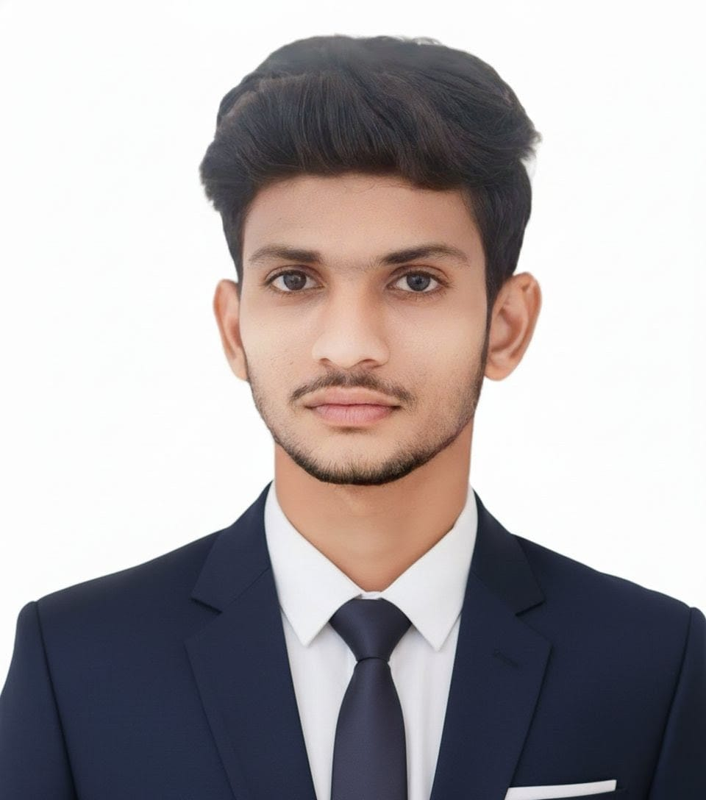
PURNA CHANDRA RAO CHIMATA
PYTHON FULL STACK DEVELOPER
Chennai, India
purnachandraraochimata@gmail.com
linkedin.com/in/purnachandraraochimata
github.com/Purnachandraraochimata
Portfolio & Professional Overview • 2026

Slide 2
PROFESSIONAL SUMMARY
A motivated and enthusiastic Computer Science and Engineering graduate with expertise in Python, SQL, HTML, CSS, and AI-assisted web development. Skilled in software development, problem-solving, and building efficient web applications, with strong analytical ability and a commitment to continuous learning and innovation. Eager to contribute to impactful technology-driven projects while growing professionally within a dynamic organization.
CORE STRENGTHS
Practical, working solutions in Python, SQL and HTML/CSS
Applied AI & Machine Learning: image processing, secure data handling
Clean, documented, maintainable code and version control discipline
Cloud fundamentals (AWS) and core networking (CCNA)
B.Tech, Computer Science
& Engineering
Vel Tech RS&T, 2022–2026
02

Slide 3
EDUCATION
Academic background and achievements
2022 – 2026
Bachelor of Technology, Computer Science & Engineering
Vel Tech Rangarajan Dr. Sagunthala R&D Institute of Science and Technology
CGPA: 8.04 / 10
2020 – 2022
Intermediate (MPC)
Narayana Junior College, Andhra Pradesh
Score: 85.4%
2019 – 2020
SSC
Akshaya Vidyalayam, Andhra Pradesh
Score: 95.83%
03

Slide 4
TECHNICAL SKILLS
Proficiency across core languages, tools and platforms
HTML
90%
CSS
95%
Python
85%
SQL
80%
Git & GitHub
80%
OOP
75%
AI & Machine Learning
65%
Cloud (AWS)
70%
Networking (CCNA)
70%
Certifications: AWS Academy Cloud Foundations • CCNA Fundamentals • Generative AI for Beginners • Data Analytics • Design Drones for Smart Applications
04

Slide 5
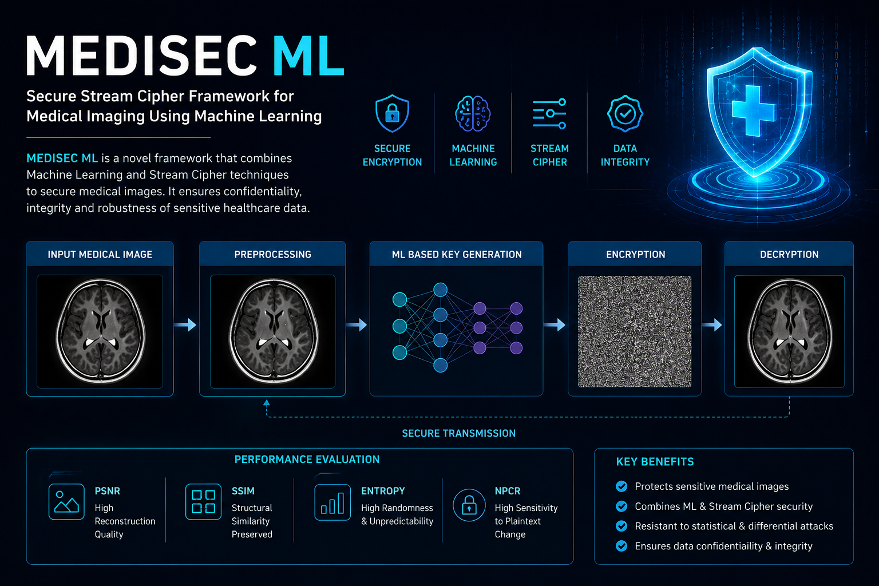
FEATURED PROJECT
MEDISEC ML
Secure Stream Cipher Framework for Medical Imaging Using Machine Learning
Designed a machine learning-based secure stream cipher framework to protect medical images. Implemented encryption and decryption pipelines and evaluated system performance using PSNR, SSIM, Entropy and NPCR metrics to confirm reconstruction quality, structural similarity, randomness and sensitivity to plaintext changes.
Performance validated on PSNR, SSIM, Entropy and NPCR metrics.
TECHNOLOGIES
Python
Machine Learning
TensorFlow
OpenCV
Image Encryption
Confidentiality • Integrity • Robustness
github.com/Purnachandraraochimata/medisecml
05

Slide 6
ADDITIONAL PROJECTS
IoT Based Fertilizer System for Smart Agriculture
Developed an IoT-based system to monitor soil moisture, pH and nutrient levels
Automated fertilizer recommendations to improve agricultural efficiency
Performed system testing and debugging to ensure reliability
AI-Based Healthcare Transportation Management System
Developed an AI-powered transport management system for healthcare services
Applied machine learning techniques for route optimization and predictive analysis
Improved emergency response efficiency through intelligent transportation planning
06

Slide 7
THANK YOU
Let's connect and build something practical together.
EMAIL
purnachandraraochimata@gmail.com
PHONE
+91 89195 00899
LINKEDIN
linkedin.com/in/purnachandraraochimata
GITHUB
github.com/Purnachandraraochimata
LOCATION
Chennai, India

